Slide 1
CIPHENSE TASK 1
Submitted by: Nischay Nirajit Mahanta
NIT Rourkela
Gmail id: nischay.nirajit16@gmail.com

Slide 2
PROBLEM STATEMENT:
In a map of india, the cities with population greater then 5lacs are to be marked

Slide 3
Solution:
The above problem is solved using python. Modules used in the code is ‘csv’ and ‘folium’.
Initially I have taken a dataset which consist of Name population and coordinates as its attributes.
csv : it is used to import the dataset from .csv format to a list, where each list consist of a tuple that consist of each row of the table.
folium: this is used to import a map which is written in html. Using the functions of folium I was able to mark all the cities.

Slide 4
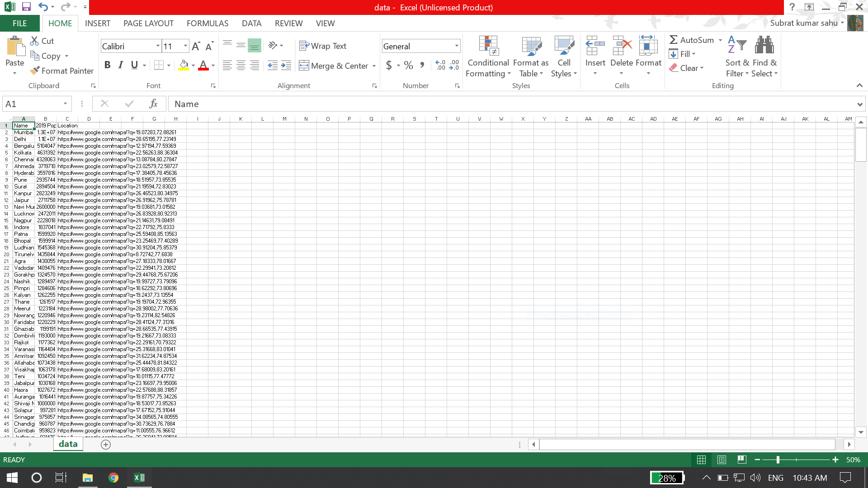
Dataset:
Consist of Name, population and location in a single tuple

Slide 5

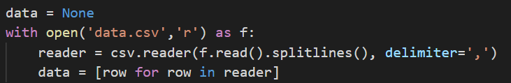
Code:
Importing the modules
Importing the map
Reading the dataset

Slide 6
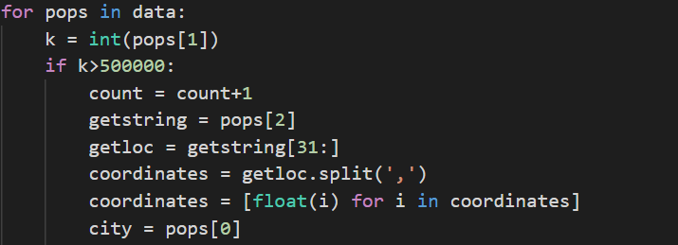
Code:
Check for population:
Marking on the Map:
Saving the map:

Slide 7
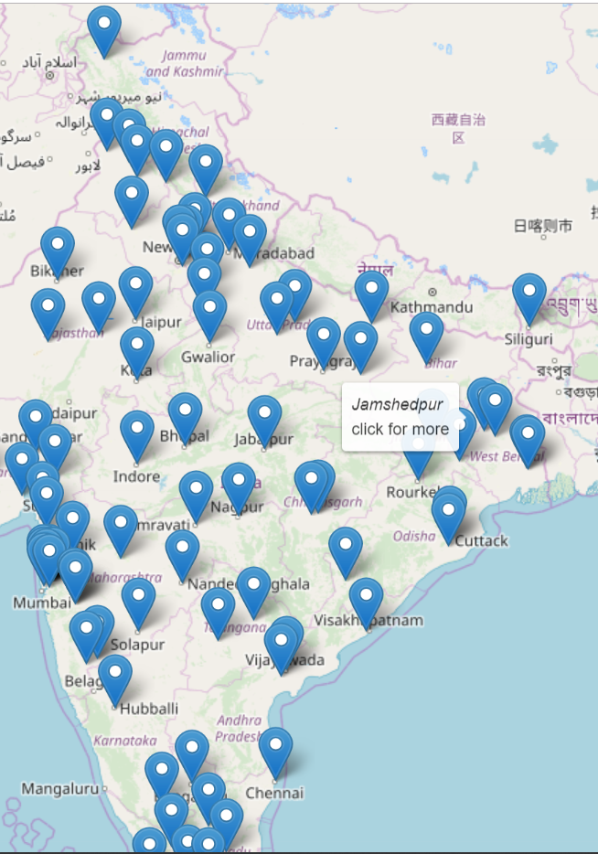
Final Output:

